Slide 1


Presentación
Arrancando motores v. 2023

Slide 2
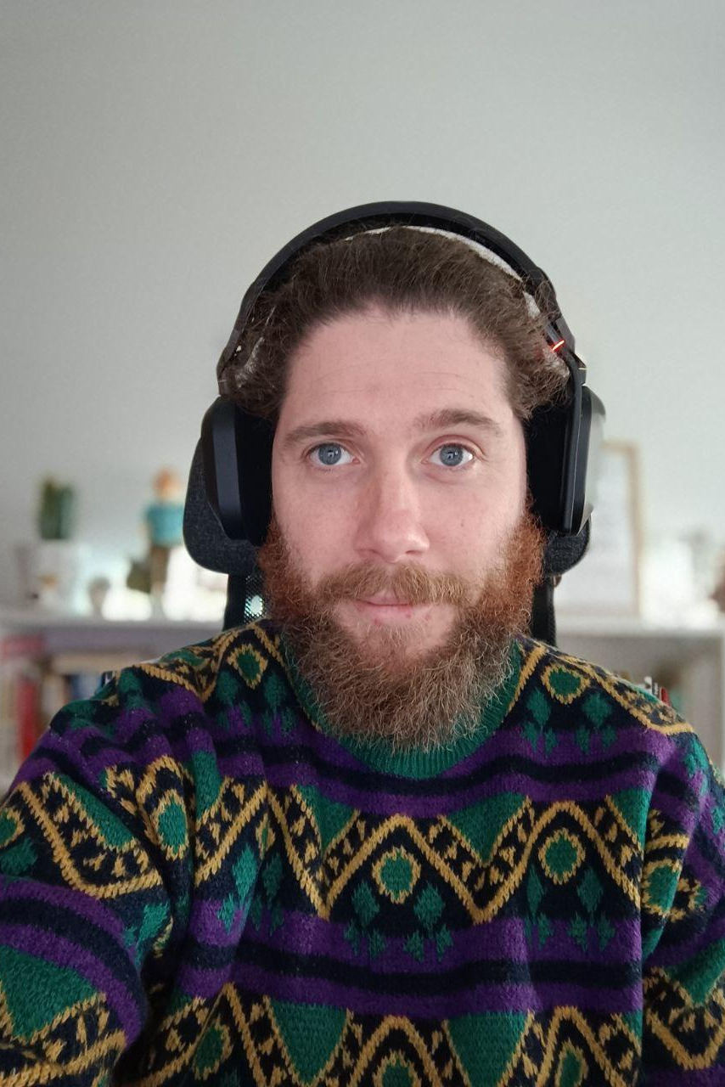
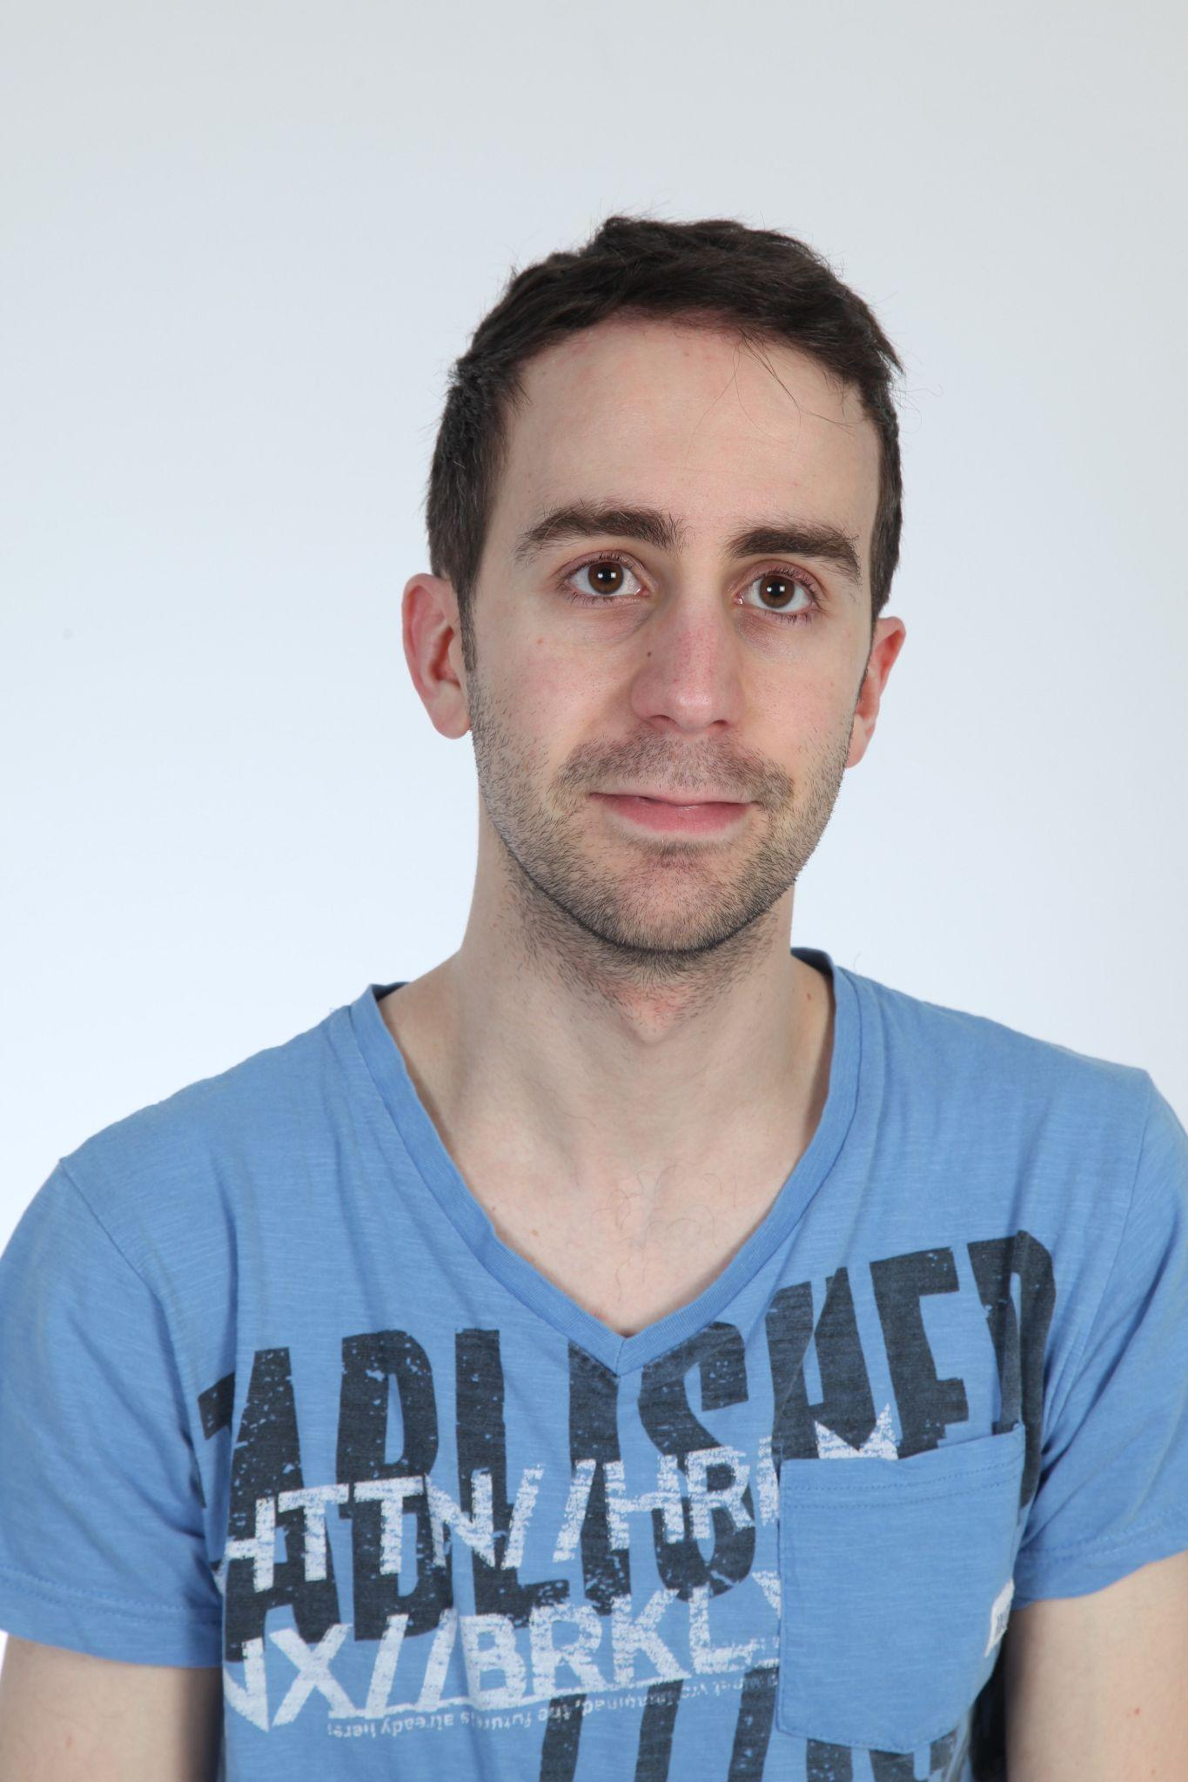
¿Quiénes somos?
Bili Almeida
🐥@aabilio
👨‍💻 Dev en Audiense
Diego Rodríguez
🐥@diegorosec
👨‍💻 Dev at PlainConcepts
Notes:
¿Por qué nos hemos presentado voluntarios para arrancarlo de nuevo?

Slide 3
Objetivos del grupo
Generar espacios de debate
Compartir conocimiento
Fomentar charlas didácticas para ayudar a personas y organizaciones
Promover
Debates, formaciones, katas y talleres

Slide 4
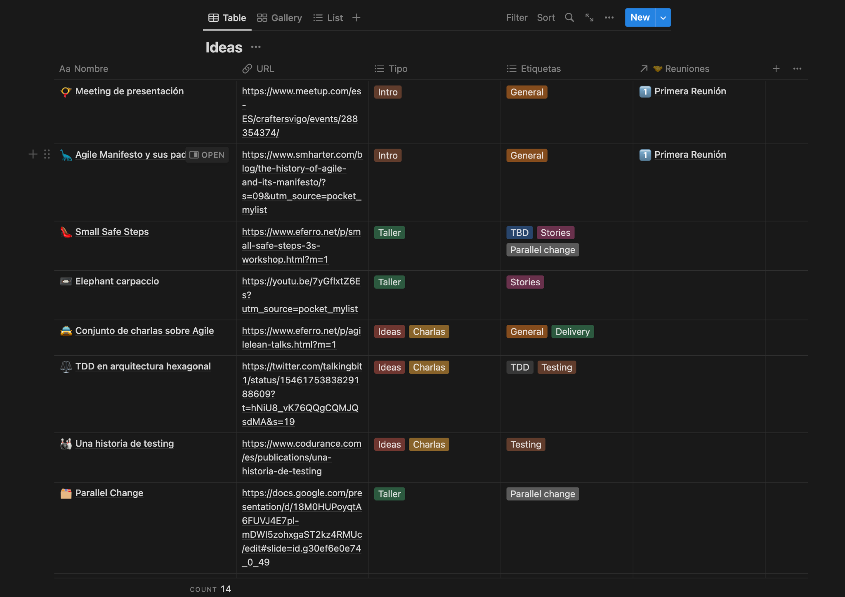

Slide 5
Back to the basics

Slide 6
Agile Moneyfesto 💸🤑
¿Hemos perdido el norte?
¿Estamos realmente aplicando metodologías ágiles con sentido?
https://agilemoneyfesto.com/

Slide 7
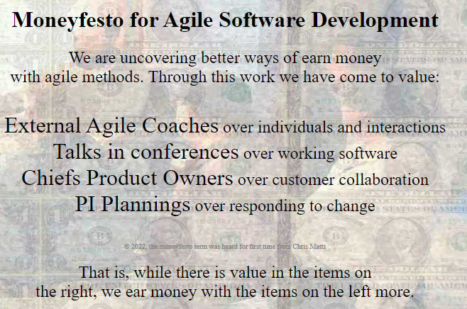

Slide 8
Principles Behind the Agile Moneyfesto
Our highest priority is to exploit the customer through early and continuous delivery of agile coaches without value.
Welcome changing ideas, even late in contract finalization. Agile processes harness change for signing a new long term contract.
We must certificate people frequently, from a couple of weeks to a couple of months, with a preference to the shorter timescale.
Business people and sales managers must eat together frequently in Michelin’s restaurants throughout the project.
Sign projects around motivated individuals. Give them presents, holidays travels and support they need, and trust them to sign the new contract.
The most efficient and effective method of conveying information to and within a development team is asking powerful questions.
Revenue is the primary measure of progress.
Agile long term contracts promote sustainable economic profit.
Account Managers, external developers, and external agile coaches should be able to maintain a constant income indefinitely.
Continuous attention to technical excellence and good design is important if we can sell 3 manual testers and 1 devops for each team.
Simplicity--the art of maximizing our agile experience in linkedin, conferences and twitter --is essential.
The best architectures, requirements, and designs emerge from subcontracted teams in a low cost country.
At regular intervals, the team practice tree hugging, play legos and paint animals 🤣 to become more friendly, then tunes and adjusts its behavior accordingly.

Slide 9
Agile Manifesto
Manifiesto para desarrollo ágil
Principios ágiles
https://agilemanifesto.org/
https://agilemanifesto.org/principles.html
Notes:
Aquí la idea es revisar el manifesto real y comentar con la gente que asista.

Slide 10
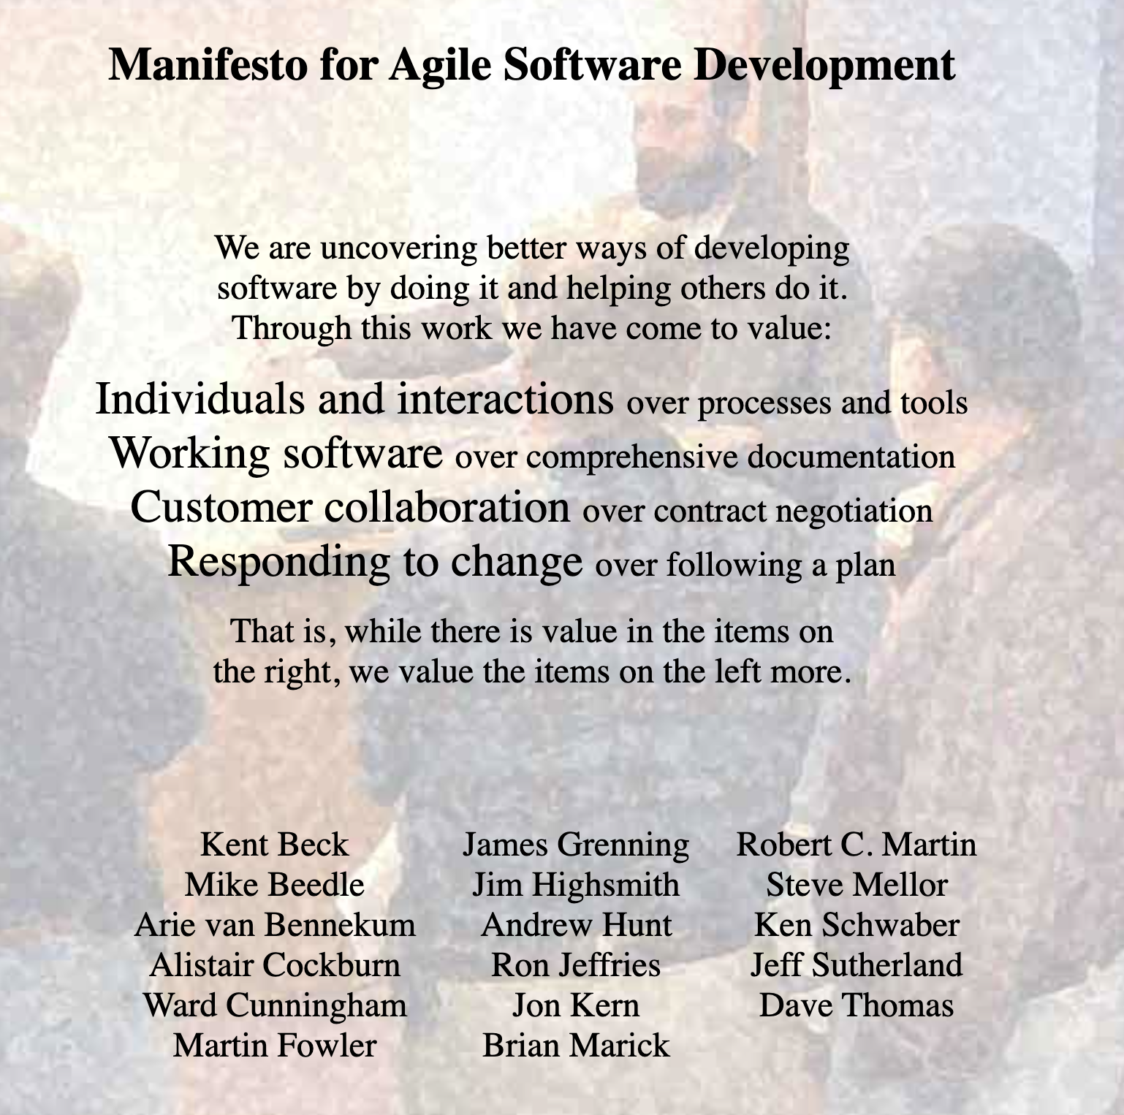

Slide 11
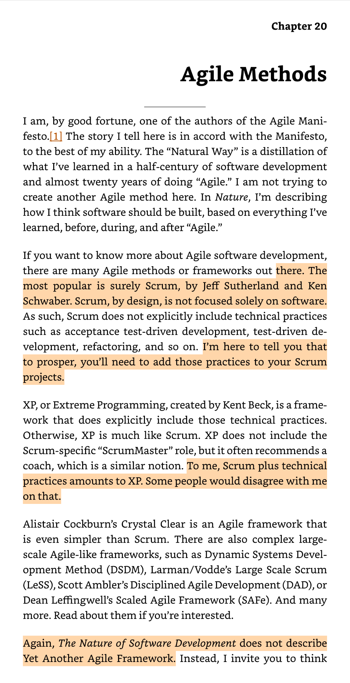
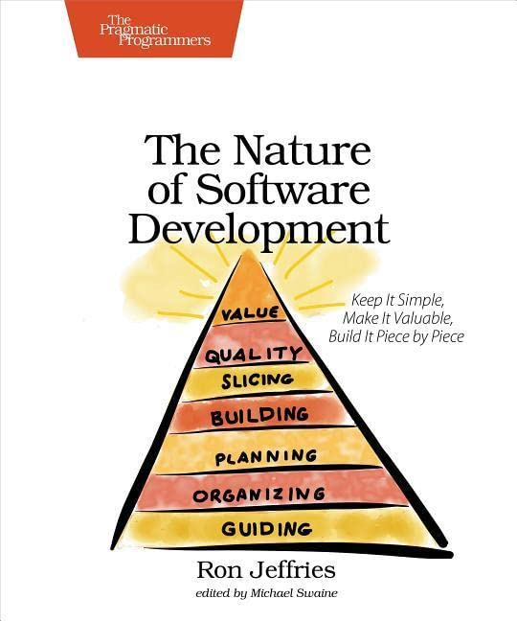
Autores
Ron Jeffries
The nature of Software development

Slide 12
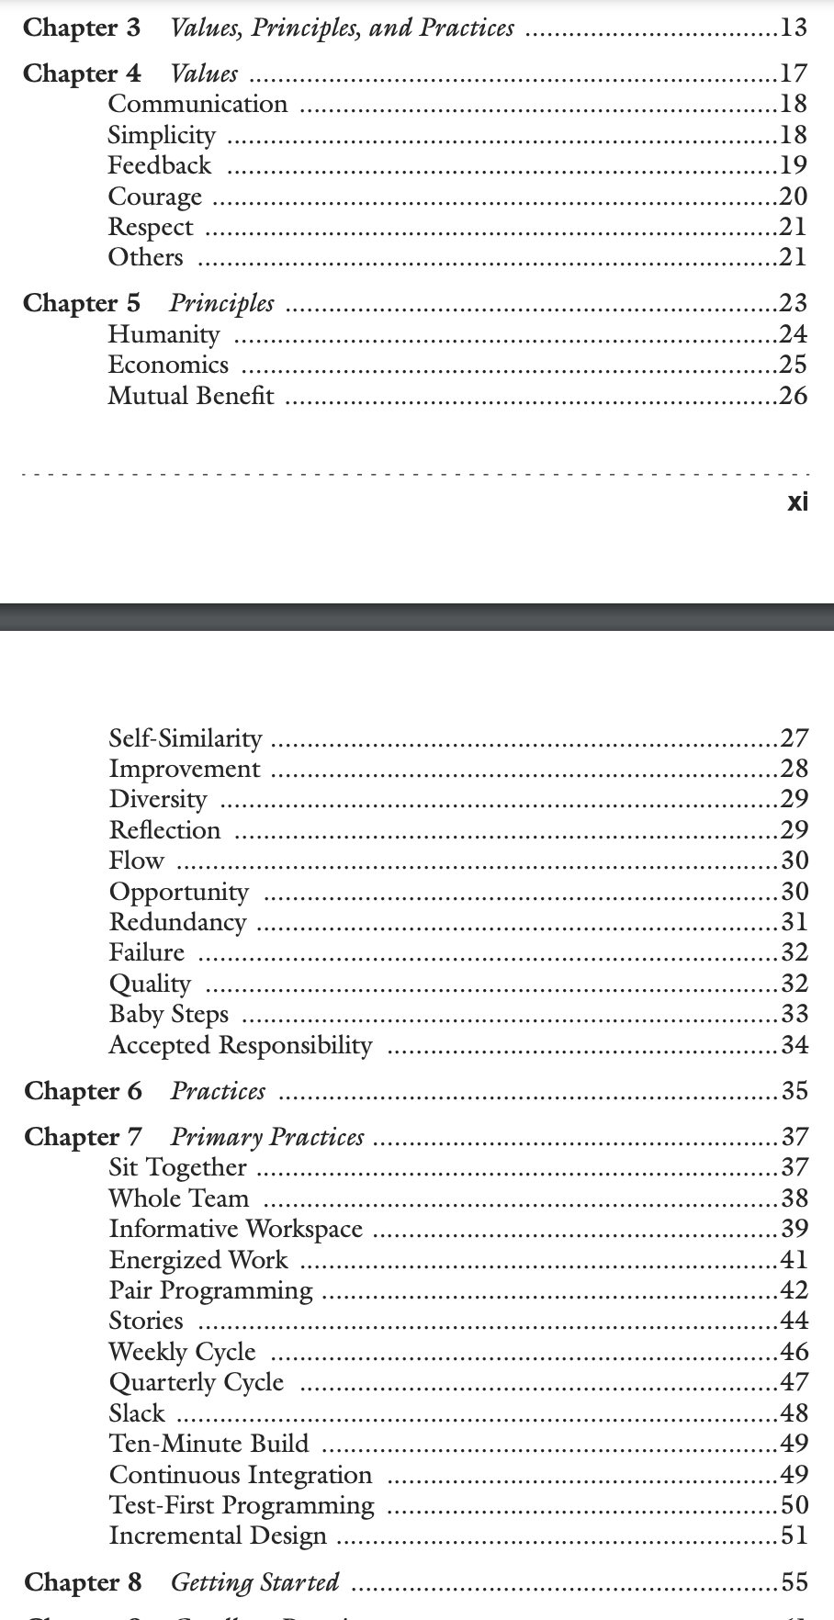

Autores
Kent Beck
Extreme Programming Explained

Slide 13

Autores
Martin Fowler
Refactoring. Improve the Design of Existing Code

Slide 14
Twitter, ¿un ejemplo de…?

Slide 15
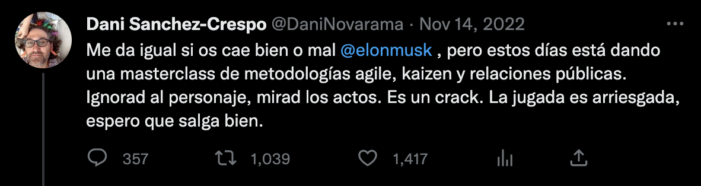
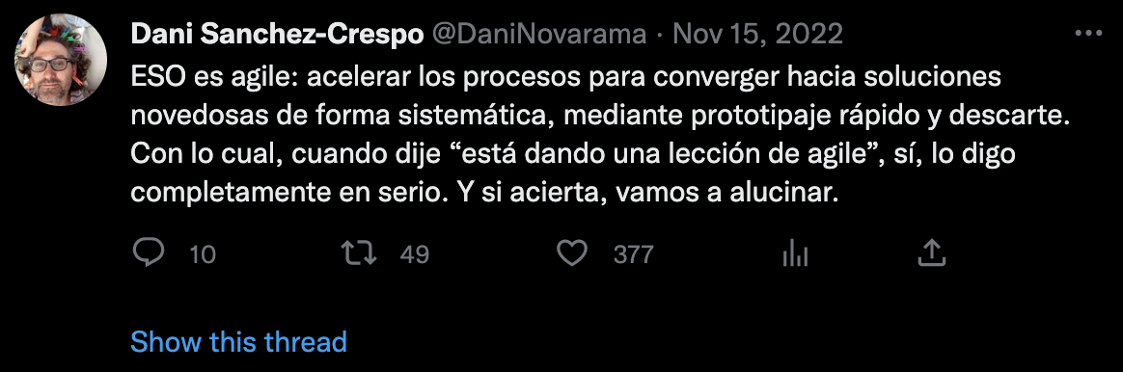
¿Master class o nada que ver?

Slide 16
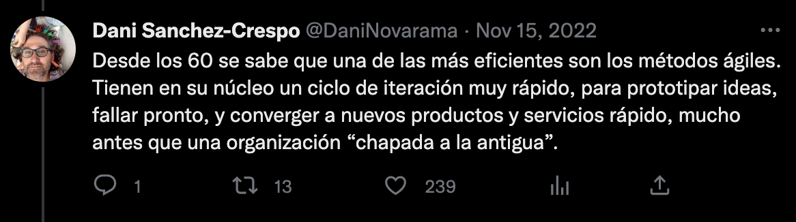
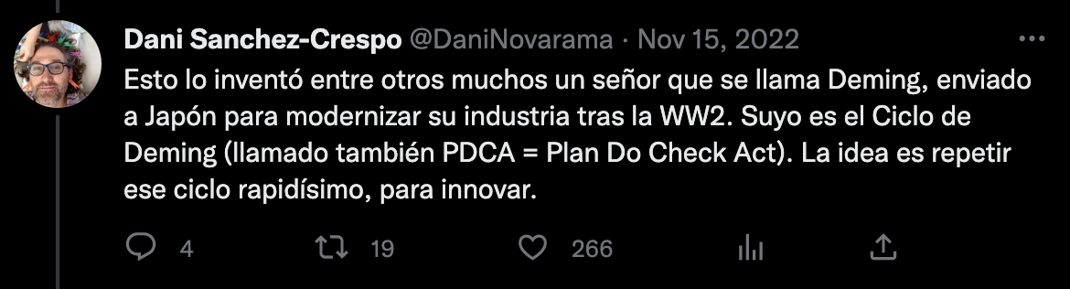
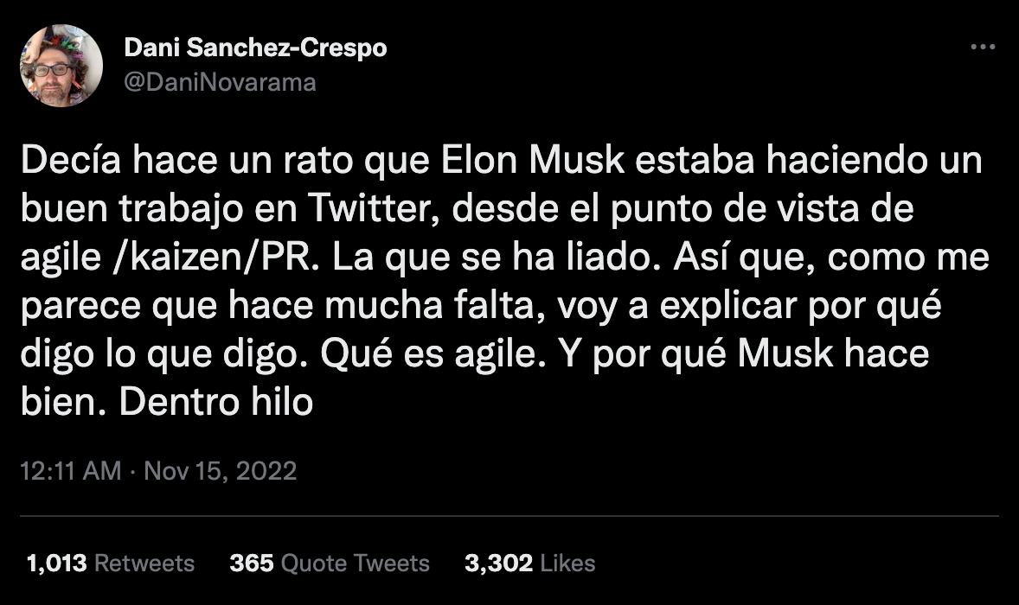
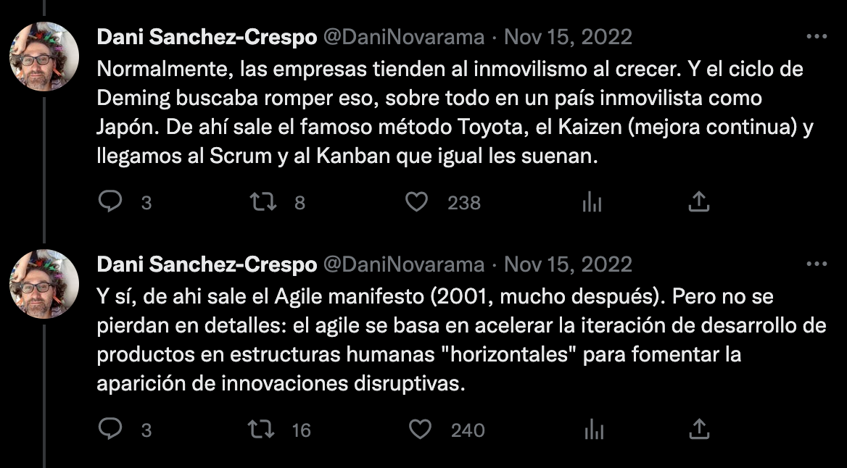

Slide 17
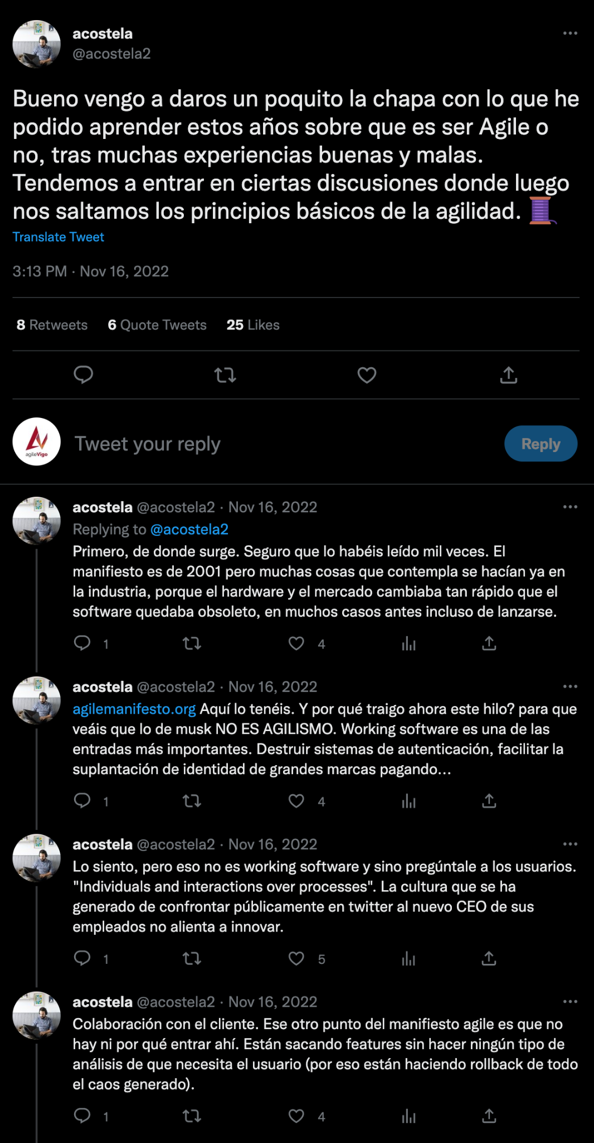
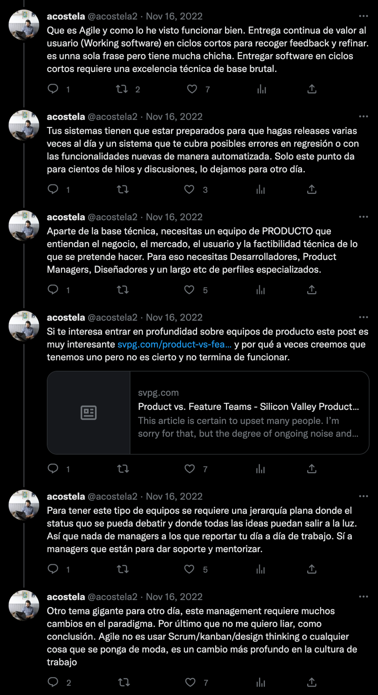
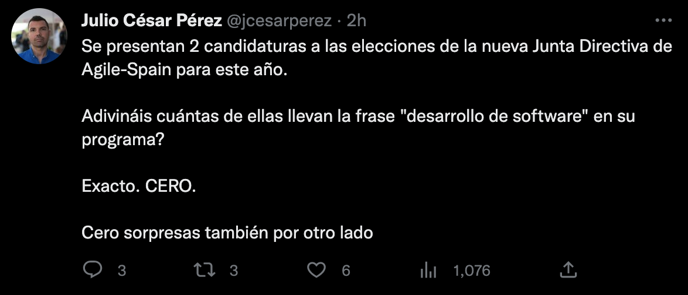

Slide 18

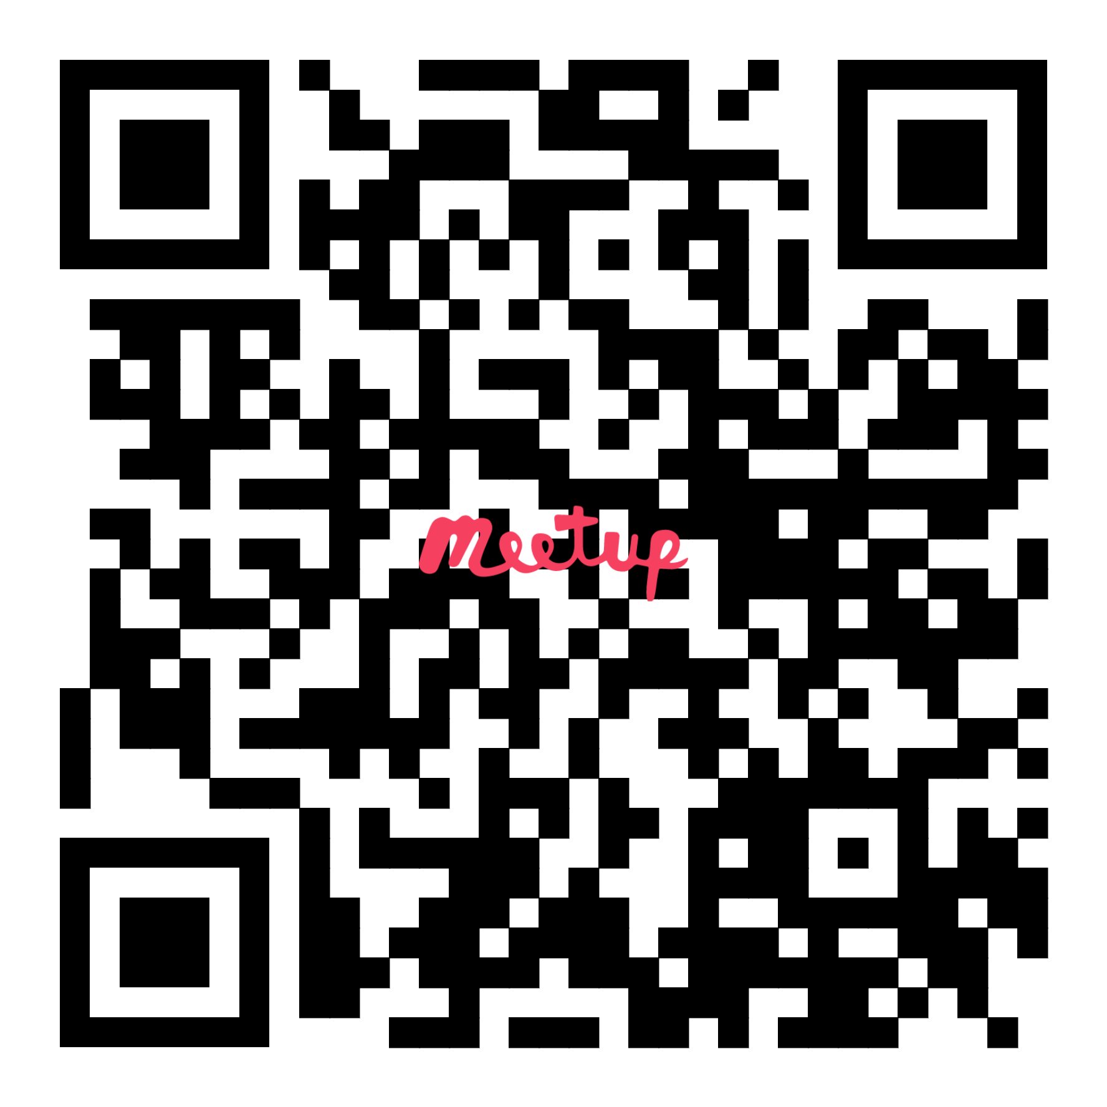
¡Gracias por participar!
https://www.meetup.com/agile-vigo/
https://twitter.com/agilevigo
https://github.com/agileVigo
https://vigotech.org/

Slide 19
Presentación
Arrancando motores v. 2023

